Slide 1



S.M.S
Smart Mirror System
Deajeon Univ. Linc 3.0 Industrial Parks
Younghoon Yoon
Deajeon Univ. Computer Science
Honggyo Lee, Hamin im

Slide 2
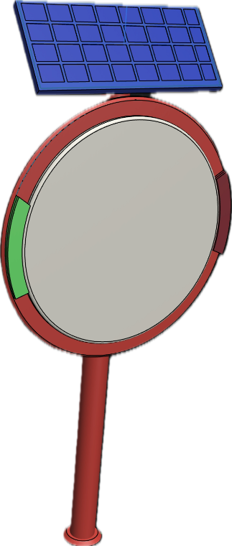
Contents
Introduction
• Who participated in the project?
• Creative process
• Problem recognition
• Idea to solve the problem
• Development motivation
• What is S.M.S?
Objective
• S.M.S operation Scenario
• What are the technologies?
• The developed prototype
• Future technologies to be added
• Demonstration video
• Benefit & What can it be used for?

Slide 3




Who participated in the project?
Honggyo Lee
Hamin Im
Daejeon Univ. Computer Science
GDSC Daejeon Univ. Member (23-24 Season)
3rd place in 2022 Metaverse Developer Contest
3rd place in 2023 Daejeon Youth Social Startup Hackathon
https://github.com/LeeHongyo
2_hong_gyo
Daejeon Univ. Computer Science
Republic of Korea Air Force Sgt. Discharged
Winning the 'Best Innovation Award' at the e-ICON World Competition
3rd place in 2023 Daejeon Youth Social Startup Hackathon
https://github.com/limhamin
be_ta_min

Slide 4
Problem recognition
According to Vietnamese statistics,
the number of registered motorcycles
has exceeded about 65 million as of 2022.
More than half of Vietnam's population owns motorcycles.
Source. (https://dream.kotra.or.kr/)
According to a WHO survey, Vietnam has about 9,000 traffic deaths a year, with one death per hour. It's like wasting 2.5% of the country's GDP.
According to WHO statistics, the number of people killed in traffic accidents in Thailand and Vietnam is 32.6 and 26.1 per 100,000 respectively, the highest in the world
Source. (http://www.insidevina.com)

Slide 5


Development motivation
Vietnam has a high rate of motorcycles worldwide and a high rate of traffic accidents worldwide.
Vietnam’s GDP losses are huge as Vietnamese people die in Motorcycle accidents.

Slide 6

Creative process
Blind spots defined
The blind spot we defined
refers to the area where drivers or pedestrians can’t see ahead.
For example, if there is a curve ahead, it refers to areas or dark roads
that can’t be seen 100 meters ahead.
Notes:
사각지대 정의:
우리가 정의한 사각지대는 운전자 혹은 보행자가 전방을 볼 수 없는 영역을 말합니다. 예를 들어 전방에 커브가 있는 경우 100m 전방에서 볼 수 없는 영역이나 어두운 길들을 말합니다.
The blind spot we defined refers to the area where drivers or pedestrians cannot see ahead. For example, if there is a curve ahead, it refers to areas or dark roads that cannot be seen 100 meters ahead.

Slide 7

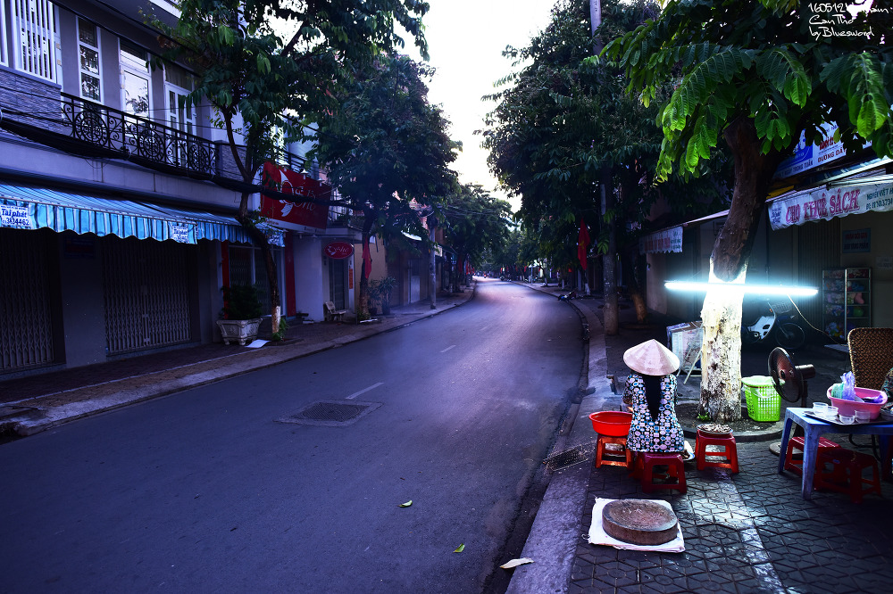
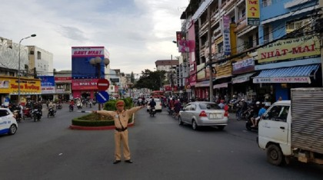
Creative process
We have identified the reason for the accident.
We identified the reason for the accident.
It's usually caused by the inability to slow down in blind spots
We have created a system that visually alerts the driver if there is a person in front of us in a blind spot.
< Unduryeong, Hongcheon in Korea>
< A dark alley in Can Tho, Mekong Delta >
< Traffic control with hand signals without traffic lights >
Notes:
사각지대 정의:
우리가 정의한 사각지대는 운전자 혹은 보행자가 전방을 볼 수 없는 영역을 말합니다. 예를 들어 전방에 커브가 있는 경우 100m 전방에서 볼 수 없는 영역이나 어두운 길들을 말합니다.
The blind spot we defined refers to the area where drivers or pedestrians cannot see ahead. For example, if there is a curve ahead, it refers to areas or dark roads that cannot be seen 100 meters ahead.

Slide 8
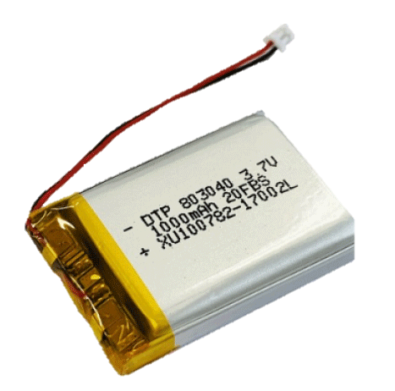
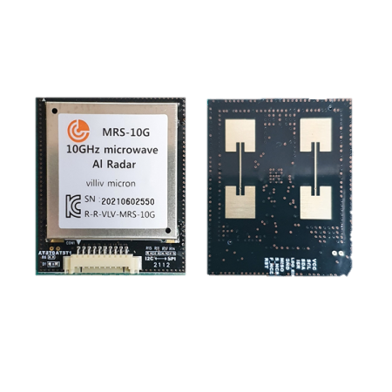
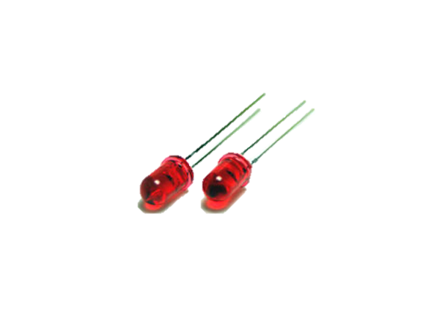
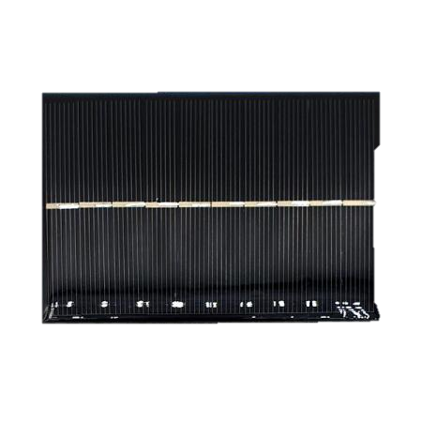
Idea to solve the problem
1. Objects in blind spots are recognized using a radar sensor, allowing pedestrians and other drivers to easily identify them.
- The LED, which is normally off, glows red so that you can easily determine the direction depending on the approaching object.
2. If the installation location does not have a smooth electricity supply,
power can be charged by using the solar penal to charge the battery
installed inside.
3. By adding functions to the existing block mirror, it is designed to ensure minimum safety functions even if it does not operate due to long-term uncharged
S.M.S.(Smart Mirror System)

Slide 9




이 슬라이드 수정??
What is S.M.S?
The Smart Mirror System is an item that aims to reduce accidents by detecting “blind spots”, the biggest risk factors on the road, to ensure the safety of cars, motorcycles, and pedestrians.

Slide 10
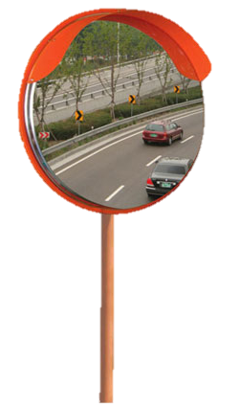
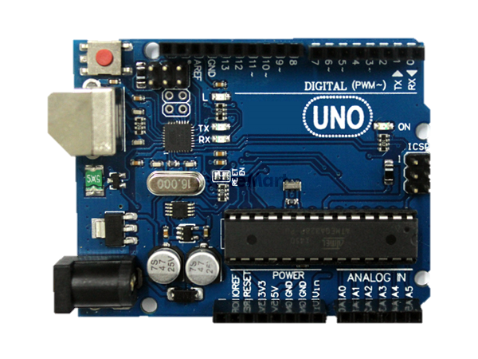
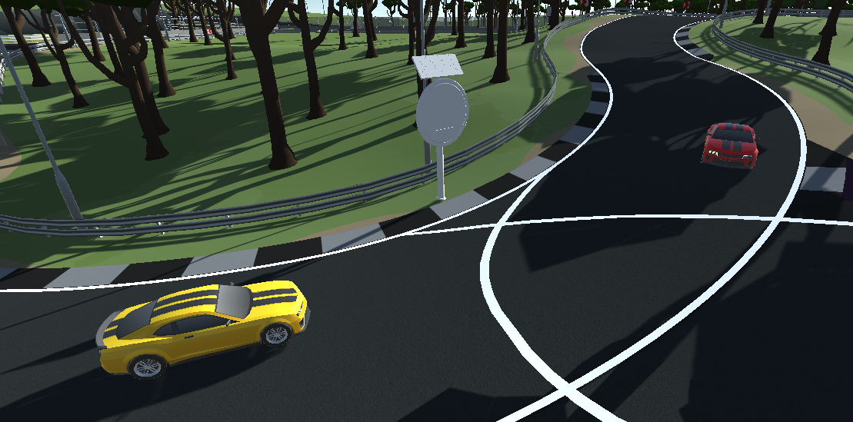
S.M.S operation Scenario
Using radar sensors, detects approaching pedestrians and motorcycles
With detected sensor signal, the processing unit of the S.M.S. generates a control signal for alarm
Depending on the direction of the approaching object, an appropriate signal is sent to the appropriate LED so that the appropriate LED can emit light.
Alerts pedestrians and drivers with visually displayed warning signals

Slide 11
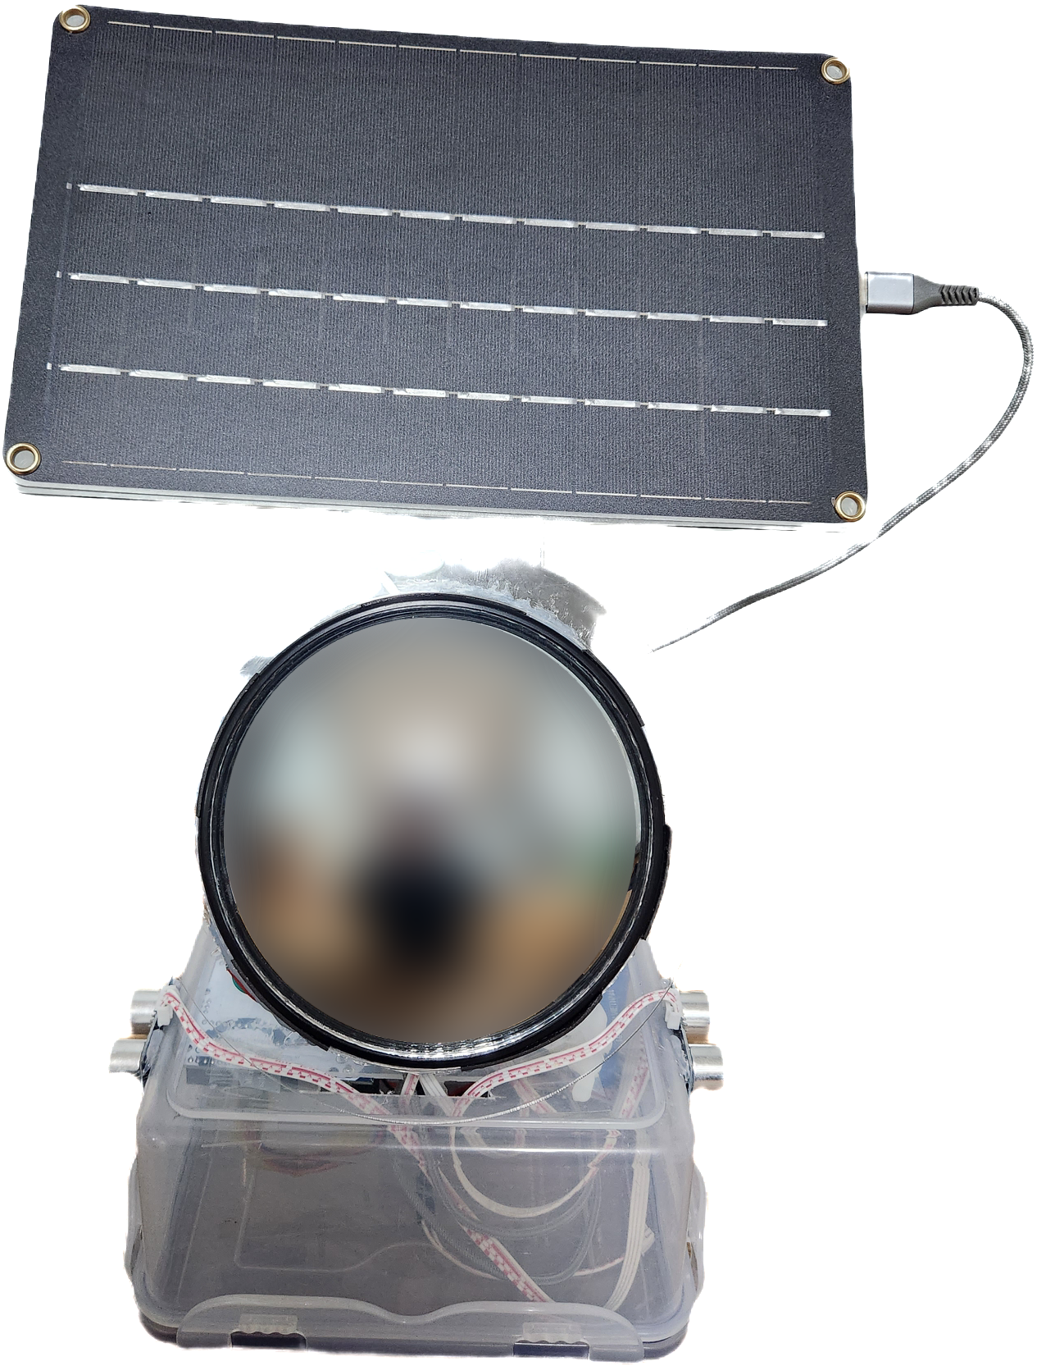
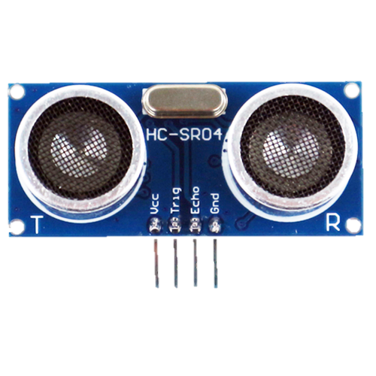
The developed prototype
Solar panel
Charge the battery through Solar power
LED (Red)
Glows red when distance is detected
Sonic Sensor
Ability to detect distance

Slide 12
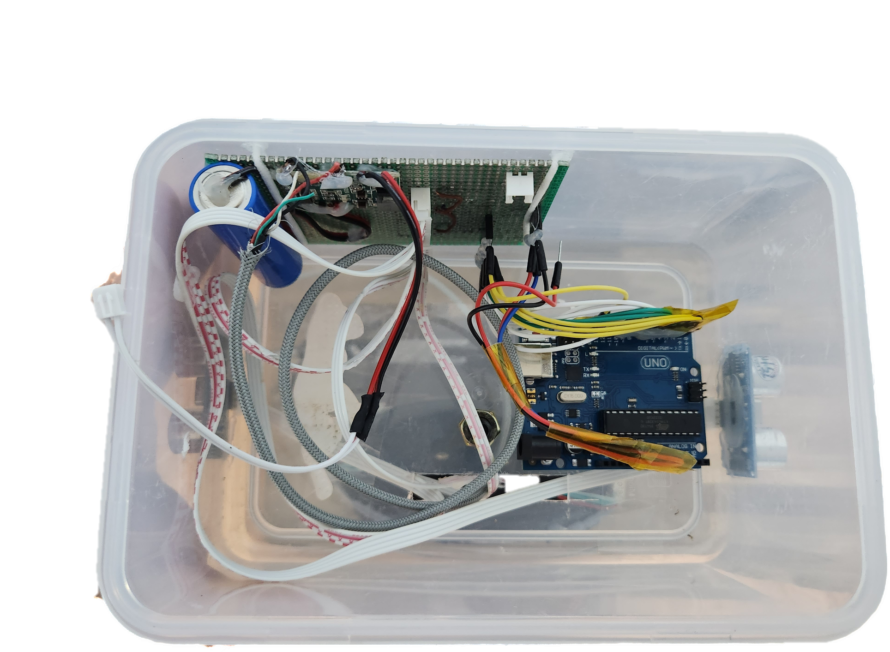
The developed prototype
Arduino
Sensor and LED
operation control
Battery
Positive battery of 1000 mAh (working unit power)

Slide 13
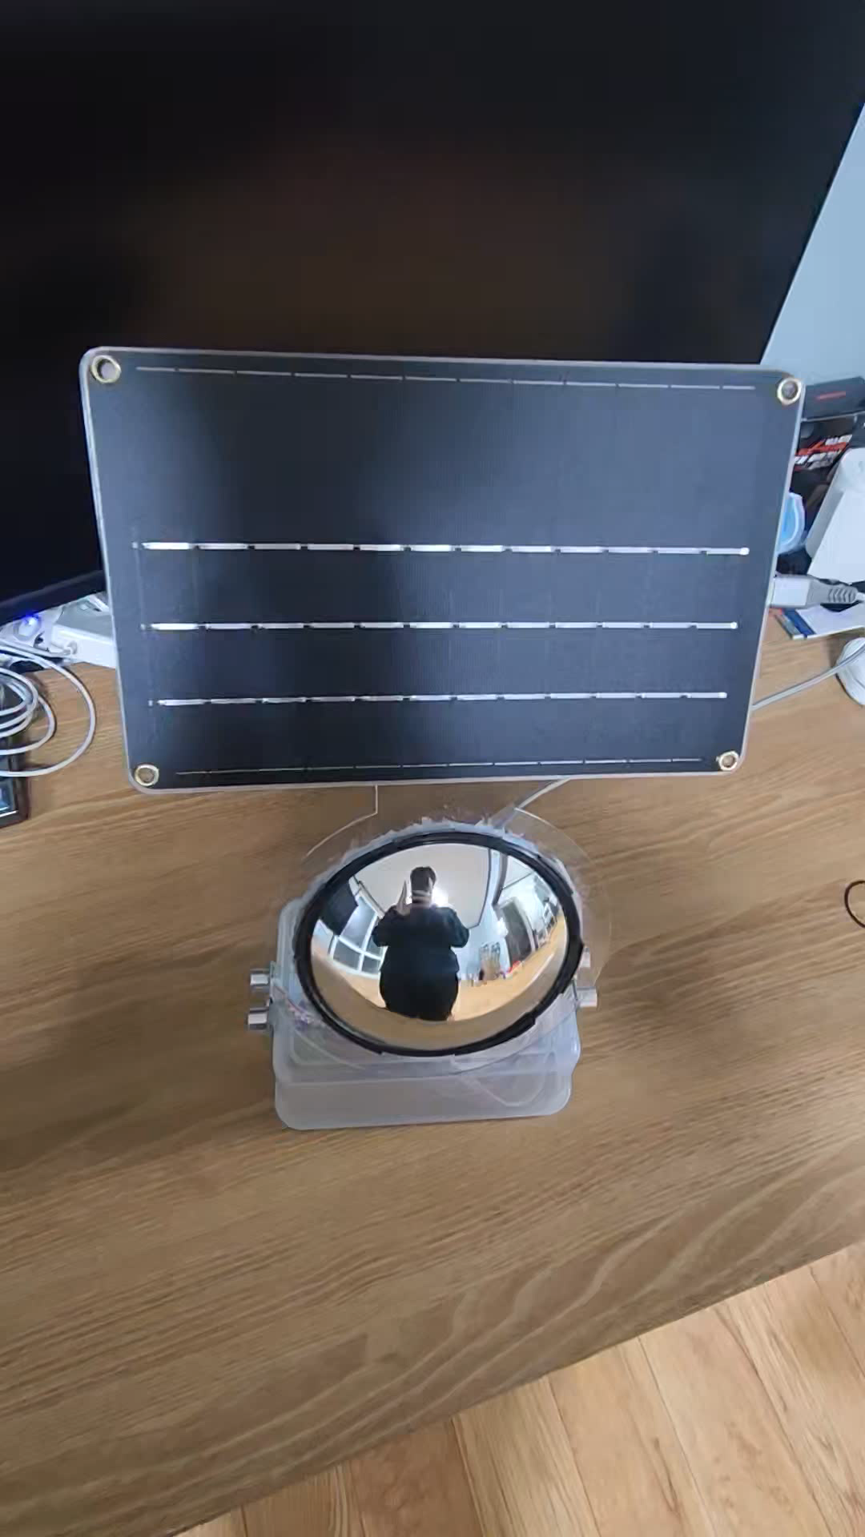
Demonstration video
시연에 대한 설명을 시각적으로 설명???

Slide 14

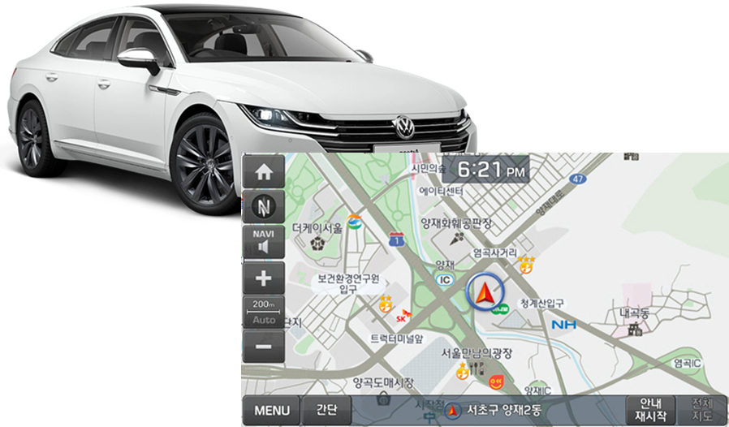

Future technologies to be added
Car navigation (Google map, Maps Me etc.), direct notification by communicating with personal cell phone
You can pay more attention to your safety by notifying drivers and pedestrians of your smartphone alarm.

Slide 15




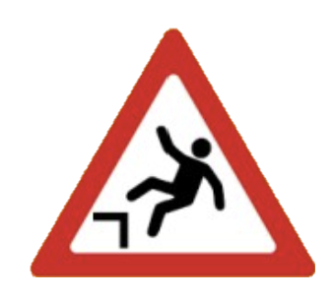
Future works
Can Tho University's experiment to build a suitable form for Vietnam
Prevention of ship collisions in the dark night, prevention of tourists from falling into rivers
Notes:
베트남에 적합한 형태를 구축하기 위한 껀터 대학의 실험.

Slide 16





Benefit & What can it be used for?
It can be used to prevent accidents around the river
Alerts car and
motorcycle drivers in traffic blind spots
Makes walking safer for pedestrians

Slide 17
Thank you

